Slide 1



CSE 315: Artificial Intelligence
Local Search
Green University of Bangladesh

Slide 2
Local Search
Tree search keeps unexplored alternatives on the fringe (ensures completeness)
Local search: improve a single option until you can’t make it better (no fringe!) New successor function: local changes
Generally much faster and more memory efficient (but incomplete and suboptimal)

Slide 3
Hill Climbing
Simple, general idea:
Hill climbing is a heuristic search algorithm that belongs to the family of local search methods. It is designed to solve problems where the goal is to find an optimal (or near-optimal) solution by iteratively moving from the current state to a better neighboring state, according to a heuristic or evaluation function.
    It is an optimisation technique used in artificial intelligence (AI) to find solutions for a wide variety of problems.
    It operates on the principle of incrementally improving a solution by making local changes and evaluating their merit.
    Its simplicity, intuitive logic and adaptability to different problems make it a go-to method.
What’s bad about this approach?
Complete? Optimal?

Slide 4
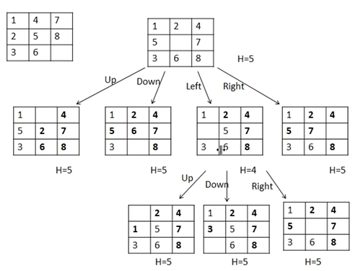
Hill Climbing

Slide 5
Hill Climbing
Hill Climbing Algorithms
Hill climbing follows these steps:
Initial State: Start with an arbitrary or random solution (initial state).
Neighboring States: Identify neighboring states of the current solution by making small adjustments (mutations or tweaks).
Move to Neighbor: If one of the neighboring states offers a better solution (according to some evaluation function), move to this new state.
Termination: Repeat this process until no neighboring state is better than the current one. At this point, we have reached a local maximum or minimum.

Slide 6
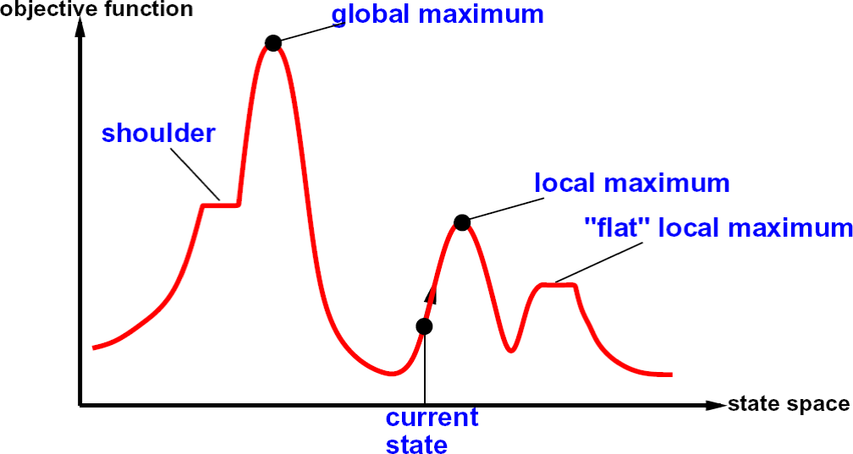
Hill Climbing Diagram

Slide 7
Hill Climbing
Key Regions in the State-Space Diagram
Local Maximum: A local maximum is a state better than its neighbors but not the best overall. While its objective function value is higher than nearby states, a global maximum may still exist.
Global Maximum: The global maximum is the best state in the state-space diagram where the objective function achieves its highest value. This is the optimal solution the algorithm seeks.
Plateau/Flat Local Maximum: A plateau is a flat region where neighboring states have the same objective function value, making it difficult for the algorithm to decide on the best direction to move.
Ridge: A ridge is a higher region with a slope which can look like a peak. This may cause the algorithm to stop prematurely, missing better solutions nearby.
Current State: The current state refers to the algorithm's position in the state-space diagram during its search for the optimal solution.
Shoulder: A shoulder is a plateau with an uphill edge allowing the algorithm to move toward better solutions if it continues searching beyond the plateau.

Slide 8
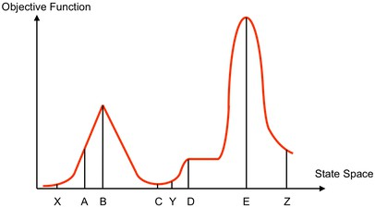
Hill Climbing Quiz
Starting from X, where do you end up ?
Starting from Y, where do you end up ? Starting from Z, where do you end up ?

Slide 9

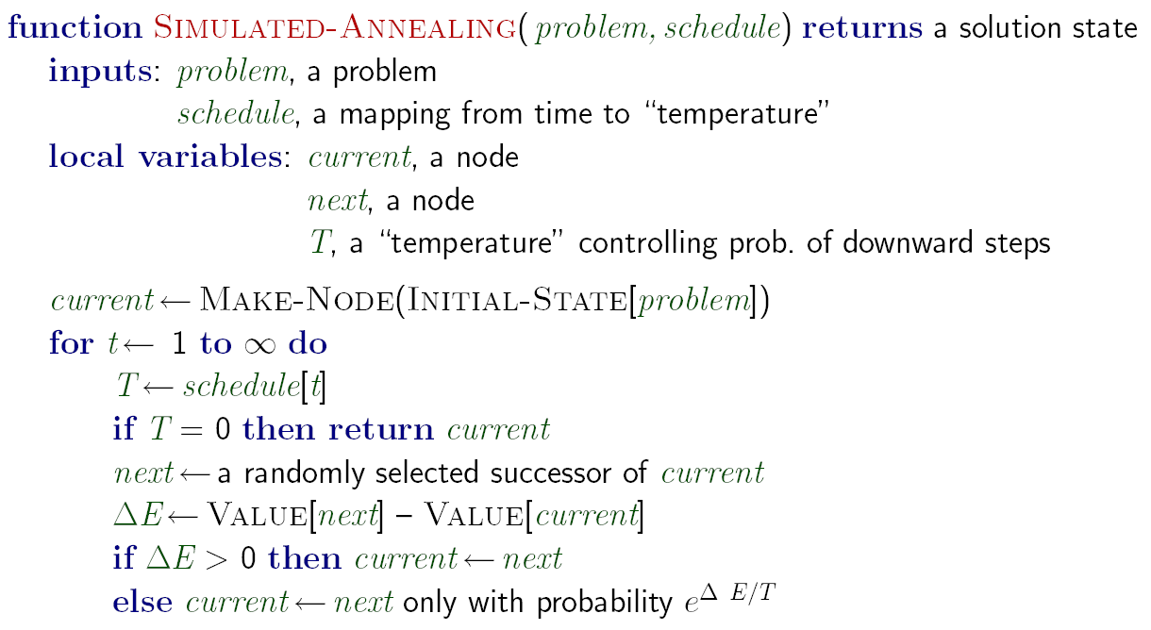
Simulated Annealing
Idea: Escape local maxima by allowing downhill moves
But make them rarer as time goes on
37

Slide 10
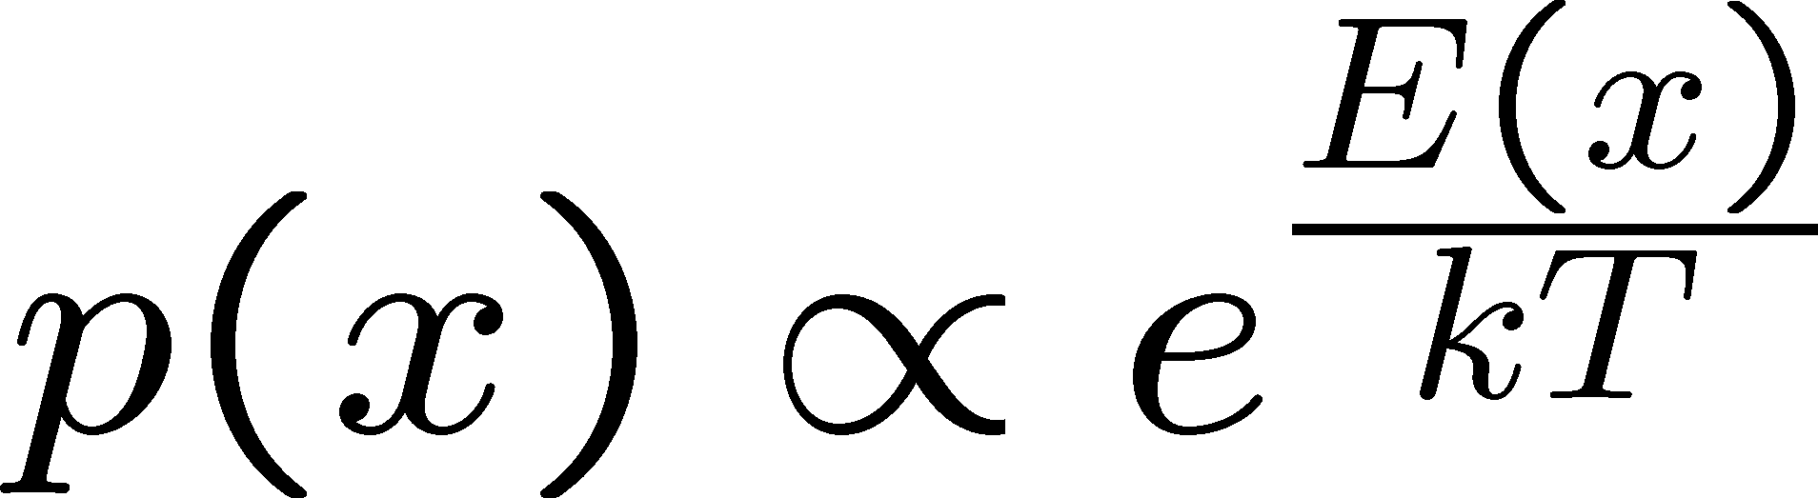
Simulated Annealing
Simulated Annealing is an optimization algorithm designed to search for an optimal or near-optimal solution in a large solution space.
Theoretical guarantee:
Stationary distribution:
If T decreased slowly enough, will converge to optimal state!
Is this an interesting guarantee? Sounds like magic, but reality is reality:
The more downhill steps you need to escape a local optimum,
the less likely you are to ever make them all in a row
People think hard about ridge operators which let you jump around the space in better ways

Slide 11
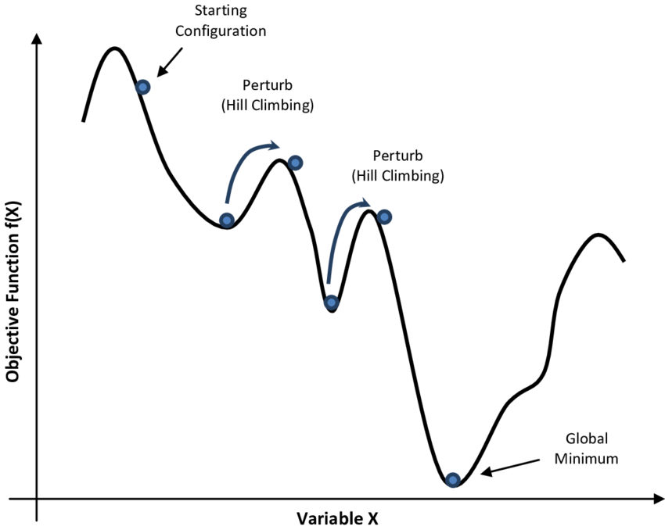
Simulated Annealing

Slide 12
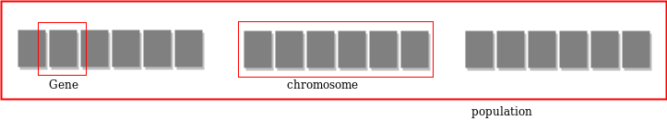
What Are Genetic Algorithms (GAs)?
Genetic Algorithms are search and optimization techniques based on Darwin’s Principle of Natural Selection.
Notes:
What exactly are Genetic Algorithms?
As the name suggests, Genetic Algorithms or Gas borrow their basic working principle from natural genetics.
Genetic Algorithms are search and optimization methods based on Darwin’s principle of Natural Selection.

Slide 13
Working Mechanism Of GAs
Begin
Initialize population
Evaluate Solutions
T =0
Optimum Solution?
N
Selection
Y
T=T+1
Stop
Crossover
Mutation
Notes:
GAs implement optimization techniques by simulating this natural law of evolution in the biological world.
We start with a population of randomly generated solutions. Each of these solutions is evaluated to determine how good or bad it is.In other words to determine how “fit” that solution is. We then check a terminating condition, to see if our solutions are good enough? If yes, we stop. If not, we have to optimize the solutions.
So, we select the best solutions from the initial population (selection). This is similar to “natural selection”.
Then we allow these good solutions to exchange their information, in order to get even better solutions. This step is similar to reproduction among animals or crossover among chrmosomes and is called “cross-over”. We may then randomly mutate some small % of the solutions thus obtained after crossover.
Mutation is very imp. It could be a bad thing, it could be a good thing. In the boliogical sense it mean, making a small change in a gene. In GAs, it means, making a small change to the solution.
Then again, we evaluate each of the sokutions, and check the termination condition. As you see , this is an optmization method.

Slide 14
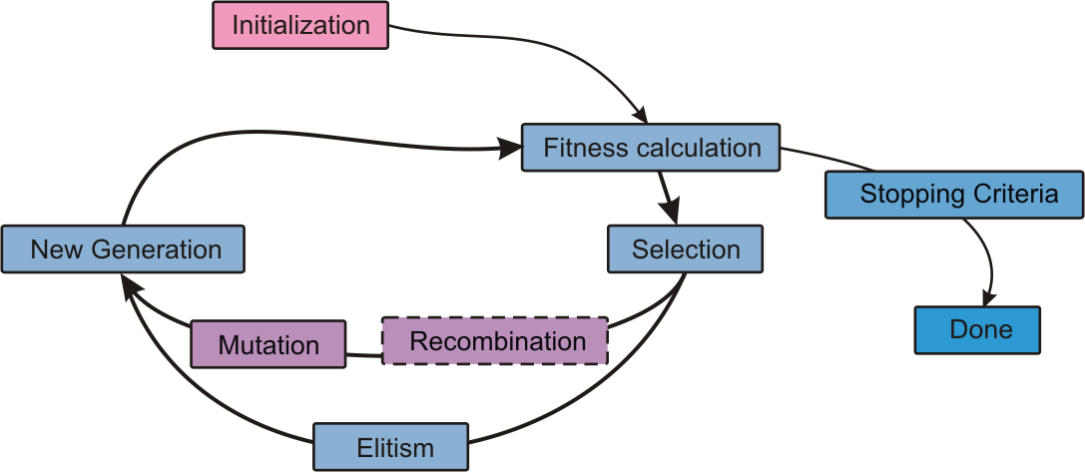
The Cycle of Evolution

Slide 15
Simple Genetic Algorithm
Simple_Genetic_Algorithm()
{
Initialize the Population;
Calculate Fitness Function;
While(Fitness Value != Optimal Value)
{
Selection;//Natural Selection, Survival Of Fittest
Crossover;//Reproduction, Propagate favorable characteristics
Mutation;//Mutation
Calculate Fitness Function;
}
}

Slide 16
Nature to Computer Mapping
Nature | Computer
Population Individual Fitness Chromosome Gene Reproduction | Set of solutions. Solution to a problem. Quality of a solution. Encoding for a Solution. Part of the encoding of a solution. Crossover
Notes:
So after this discussion, it should be clear to you that Gas mimic the natural process of evolution to a large extent. To summarize the similarities , I have a slide here.

Slide 17
Genetic Algorithm
Operators of Genetic Algorithms:
                Encoding
                Selection
                Crossover
                Mutation

Slide 18
Encoding
The process of representing the solution in the form of a string that conveys the necessary information.
Just as in a chromosome, each gene controls a particular characteristic of the individual, similarly, each bit in the string represents a characteristic of the solution.
Binary encoding
Permutation encoding
Value encoding
Tree encoding
….

Slide 19
Fitness Function
A fitness function quantifies the optimality of a solution (chromosome) so that particular solution may be ranked against all the other solutions.
A fitness value is assigned to each solution depending on how close it actually is to solving the problem.
Ideal fitness function correlates closely to goal + quickly computable.
Example. In TSP, f(x) is sum of distances between the cities in solution. The lesser the value, the fitter the solution is.

Slide 20
Selection
After deciding on an encoding, the next step is to decide how to perform selection.
That means how to choose individuals in the population that will create offspring for the next generation.
The purpose of selection is to emphasize fitter individuals in the population in hopes that their off springs have better fitness.

Slide 21
Selection
The process that determines which solutions are to be preserved and allowed to reproduce and which ones deserve to die out.
The primary objective is to emphasize the good solutions and eliminate the bad solutions in a population, while keeping the population size constant.
“Selects The Best, Discards The Rest”.

Slide 22
Selection
Identify the good solutions in a population.
Make multiple solutions from the good solutions.
Eliminate bad solutions from the population so that multiple copies of good solutions can be placed in the population.

Slide 23
Crossover
It is the process in which two chromosomes (strings) combine their genetic material (bits) to produce a new offspring which possesses both their characteristics.
Two strings are picked from the mating pool at random to cross over.
The method chosen depends on the Encoding Method such as special crossover for TSP.

Slide 24
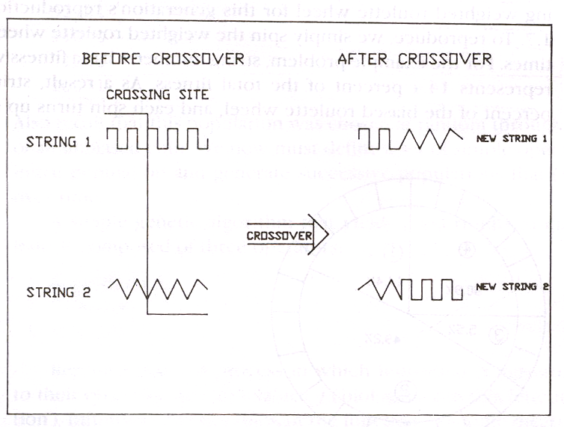
Crossover Methods
Single Point Crossover- A random point is chosen on the individual chromosomes (strings) and the genetic material is exchanged at this point.

Slide 25
Crossover Methods (contd.)
Single Point Crossover
Chromosome1 | 11011 | 00100110110
Chromosome 2 | 11011 | 11000011110
Offspring 1 | 11011 | 11000011110
Offspring 2 | 11011 | 00100110110

Slide 26
Crossover Methods (contd.)
Two-Point Crossover- Two random points are chosen on the individual chromosomes (strings) and the genetic material is exchanged at these points.
Chromosome1 | 11011 | 00100 | 110110
Chromosome 2 | 10101 | 11000 | 011110
Offspring 1 | 10101 | 00100 | 011110
Offspring 2 | 11011 | 11000 | 110110

Slide 27
Crossover Methods (contd.)
Uniform Crossover- Each gene (bit) is selected randomly from one of the corresponding genes of the parent chromosomes.
Chromosome1 | 1101100100110110
Chromosome 2 | 1010111000011110
Offspring 1 | 1011100000110110
Offspring 2 | 1110111100011110

Slide 28
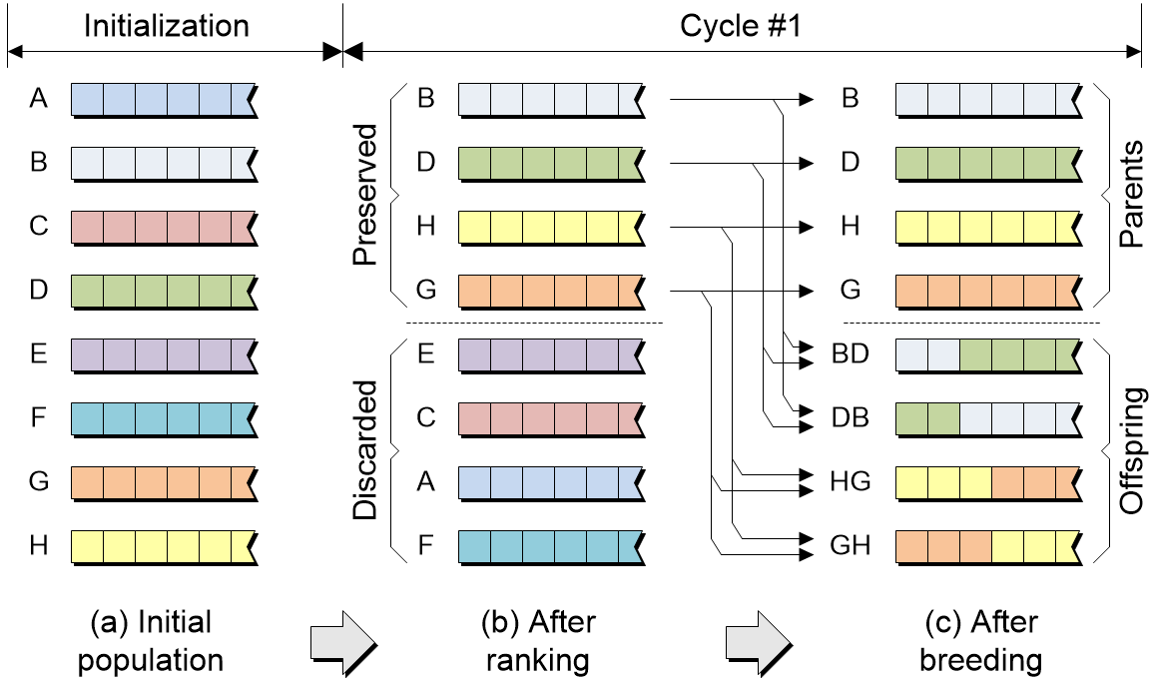

Slide 29
Mutation
Mutation is a genetic operator used to maintain
genetic diversity from one generation of a population
of genetic algorithm chromosomes to the next.
We saw in the giraffes’ example, that mutations could be
beneficial.
Mutation Probability- determines how often the parts of a
chromosome will be mutated.

Slide 30
Example Of Mutation
Flipping: For chromosomes using Binary Encoding, randomly selected bits are inverted.
Offspring | 11011 00100 110110
Mutated Offspring | 11010 00100 100110

Slide 31

Mutation
Interchanging: Two random positions of the string are chosen and the bits corresponding to those positions are interchanged.

Slide 32

Mutation
Reversing: A random position is chosen and the bits next to that position are reversed and child chromosome is produced.

Slide 33
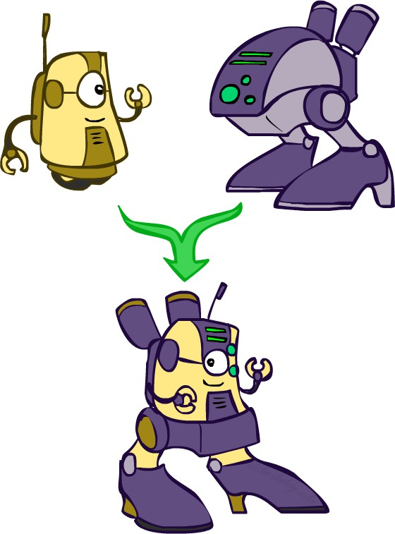
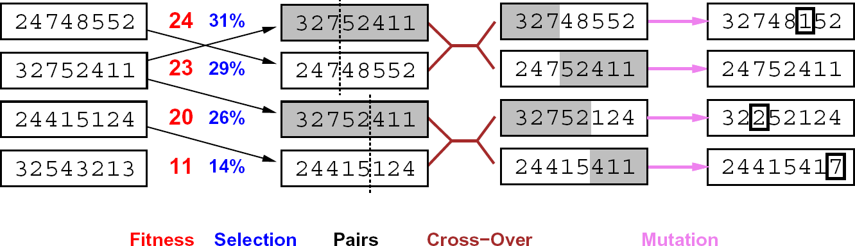
Genetic Algorithms
Genetic algorithms use a natural selection metaphor
Keep best N hypotheses at each step (selection) based on a fitness function Also have pairwise crossover operators, with optional mutation to give variety
Possibly the most misunderstood, misapplied (and even maligned) technique around

Slide 34
TSP example
Given five cities, A, B, C, D, and E, we want to find the shortest tour that visits each city exactly once and returns to the start.
Distance Matrix:
 | A | B | C | D | E
A | 0 | 10 | 15 | 20 | 25
B | 10 | 0 | 35 | 25 | 30
C | 15 | 35 | 0 | 30 | 5
D | 20 | 25 | 30 | 0 | 15
E | 25 | 30 | 5 | 15 | 0
Encoding (Chromosome):
A route is a permutation of cities, e.g. [A, C, D, B, E] (always understood to return to the start at the end).

Slide 35
TSP example
Step 1: Initial Population
We'll start by creating a random population of solutions (routes). Each solution is a permutation of the cities.
For example:
P1 = [A, B, C, D, E]
P2 = [A, C, D, B, E]
P3 = [A, D, E, C, B]
P4 = [A, E, B, D, C]
We’ll randomly choose 4 initial solutions for this small problem. In a real scenario, we’d likely use more solutions (e.g., 100).
Step 2: Fitness Evaluation
P1 = [A, B, C, D, E]
  A → B (10), B → C (35), C → D (30), D → E (15), E → A (25)
  Tour length = 10 + 35 + 30 + 15 + 25 = 115
P2 = [A, C, D, B, E]
  A → C (15), C → D (30), D → B (25), B → E (30), E → A (25)
  Tour length = 15 + 30 + 25 + 30 + 25 = 125
P3 = [A, D, E, C, B]
  A → D (20), D → E (15), E → C (5), C → B (35), B → A (10)
  Tour length = 20 + 15 + 5 + 35 + 10 = 85
P4 = [A, E, B, D, C]
  A → E (25), E → B (30), B → D (25), D → C (30), C → A (15)
  Tour length = 25 + 30 + 25 + 30 + 15 = 125
The fitness is:
Fitness for P1 = 1 / 115 ≈ 0.0087
Fitness for P2 = 1 / 125 ≈ 0.0080
Fitness for P3 = 1 / 85 ≈ 0.0118
Fitness for P4 = 1 / 125 ≈ 0.0080

Slide 36
TSP example
Step 3: Selection
We now select parents for the next generation based on fitness.
Let’s select P3 and P1 as parents for the next generation.
Step 4: Single-Point Crossover
Parent 1 (P3) = [A, D, E, C, B]
Parent 2 (P1) = [A, B, C, D, E]
Child 1 (SPX from P3 and P1):
So, we have generated two new children:
Child 1 = [A, D, B, C, E]
Child 2 = [A, B, D, E, C]
Step 5: Mutation
One common mutation for TSP is swap mutation, where two cities are swapped.
Let’s mutate Child 1:
Child 1 = [A, D, B, C, E] Swap cities B and C:
Mutated Child 1 = [A, D, C, B, E]

Slide 37
TSP example
Step 6: Replacement
Now, we create the new generation by replacing the old population with the best routes from the current generation
New population:
P3 (best from the old generation)
Child 1 (mutated) = [A, D, C, B, E]
Child 2 = [A, B, D, E, C]
Step 7: Repeat
We repeat the process (selection, crossover, mutation, replacement) for several generations. After a few generations, the algorithm will converge to the best solution.
Final Result:
After several generations, the best route found by the genetic algorithm could be:
Best Tour = [A, D, E, C, B]
Tour Length = 85 (this was the best in the first generation)

